Slide 2
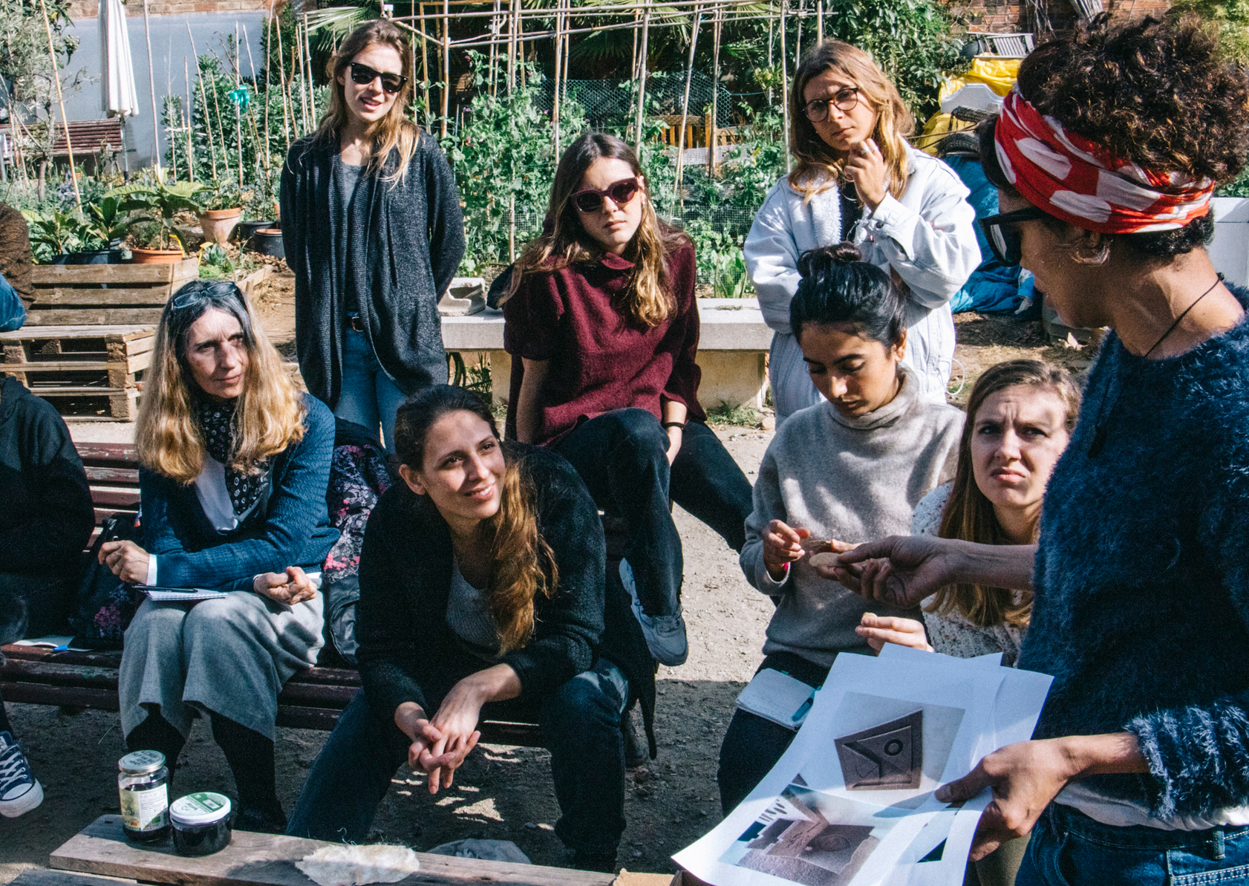
ABOUT Foodshift2030
We’re empowering citizens to shift the European food system to a low-carbon, circular and plant based future!
FOODSHIFT 2030 Presentation
03

Slide 3
City-region perspectives on providing vulnerable people with food
The COVID-19 crisis has seen city-regions across the world respond to the emergency in a number of ways, with some local initiatives truly standing out. The latter have the potential to inform other urban communities on how local and national government, and the public sector can ensure the most vulnerable have access to food, including those on very low income and in isolation.
This webinar presents these city-region responses to COVID-19, inviting participants to address the key aspects of establishing solidarity and citizen-driven initiatives to support resilience in local food systems.

Slide 4
Objectives
Learning from city-regions and broader agglomerations/urban regions about new ways of providing vulnerable people with food during the COVID19 crisis
Sharing views about how to start, explicitly discussing the role of the farmers, the interaction with existing assistance organisations, and the interaction between them and new networks aiming at assisting vulnerable people
Gaining in capacities to build resilience in the FALs: discuss the empowerment of citizens in a time of crisis and post-crisis changes

Slide 5
Recording is ON
Twitter @FoodSHIFT2030 #FoodSHIFT2030
Use (only) the Q&A section
Address technical issues in the chat

Slide 6
13:30 Welcome by Dominique Barjolle, agrathaer (leader of the Workpackage “Multiplying the Impacts” in FoodSHIFT2030 project)
13:35 Introduction by Christian Bugge Henriksen, UCPH (FoodSHIFT2030 Coordinator)
13:40 Introduction to the Food Accelerator Laboratories by Dirk Wascher, SUSMETRO (FoodSHIFT2030 Innovation Manager)
13:50 Sharing Experiences
Oostende (Ewoud Dutellie, Municipality of Oostende)
Avignon (Hugues Fortuna, Elsa Chiffard, Municipality of Avignon)
14:10 Panel discussion moderated by Ben Reynolds, SUSTAIN, UK
Stefania Amato, C40 (Network manager, Food systems)
Kemi Akinola, Be Enriched and Brixton People's Kitchen (CEO/MD, Labour & Co-operative Councillor in Wandsworth)
Ana Moragues-Faus, University of Barcelona (Senior Research Fellow, visiting fellow at the Sustainable Places Institute at Cardiff University. Author of the just released paper: “Distributive food systems to build just and liveable futures”)
14:40 Dialogue with all participants about citizens engagement and experiences made by the City Regions
14:55 Conclusion by Dirk
15:00 Closing by Dominique

Slide 7
13:30 Welcome by Dominique Barjolle, agrathaer (leader of the Workpackage “Multiplying the Impacts” in FoodSHIFT2030 project)
13:35 Introduction by Christian Bugge Henriksen, UCPH (FoodSHIFT2030 Coordinator)
13:40 Introduction to the Food Accelerator Laboratories by Dirk Wascher, SUSMETRO (FoodSHIFT2030 Innovation Manager)
13:50 Sharing Experiences
Oostende (Ewoud Dutellie, Municipality of Oostende)
Avignon (Hugues Fortuna, Elsa Chiffard, Municipality of Avignon)
14:10 Panel discussion moderated by Ben Reynolds, SUSTAIN, UK
Stefania Amato, C40 (Network manager, Food systems)
Kemi Akinola, Be Enriched and Brixton People's Kitchen (CEO/MD, Labour & Co-operative Councillor in Wandsworth)
Ana Moragues-Faus, University of Barcelona (Senior Research Fellow, visiting fellow at the Sustainable Places Institute at Cardiff University. Author of the just released paper: “Distributive food systems to build just and liveable futures” at https://link.springer.com/article/10.1007%2Fs10460-020-10087-9)
14:40 Dialogue with all participants about citizens engagement and experiences made by the City Regions
14:55 Conclusion by Dirk
15:00 Closing by Dominique

Slide 8
13:30 Welcome by Dominique Barjolle, agrathaer (leader of the Workpackage “Multiplying the Impacts” in FoodSHIFT2030 project)
13:35 Introduction by Christian Bugge Henriksen, UCPH (FoodSHIFT2030 Coordinator)
13:40 Introduction to the Food Accelerator Laboratories by Dirk Wascher, SUSMETRO (FoodSHIFT2030 Innovation Manager)
13:50 Sharing Experiences
Oostende (Ewoud Dutellie, Municipality of Oostende)
Avignon (Hugues Fortuna, Elsa Chiffard, Municipality of Avignon)
14:10 Panel discussion moderated by Ben Reynolds, SUSTAIN, UK
Stefania Amato, C40 (Network manager, Food systems)
Kemi Akinola, Be Enriched and Brixton People's Kitchen (CEO/MD, Labour & Co-operative Councillor in Wandsworth)
Ana Moragues-Faus, University of Barcelona (Senior Research Fellow, visiting fellow at the Sustainable Places Institute at Cardiff University. Author of the just released paper: “Distributive food systems to build just and liveable futures” at https://link.springer.com/article/10.1007%2Fs10460-020-10087-9)
14:40 Dialogue with all participants about citizens engagement and experiences made by the City Regions
14:55 Conclusion by Dirk
15:00 Closing by Dominique

Slide 9
13:30 Welcome by Dominique Barjolle, agrathaer (leader of the Workpackage “Multiplying the Impacts” in FoodSHIFT2030 project)
13:35 Introduction by Christian Bugge Henriksen, UCPH (FoodSHIFT2030 Coordinator)
13:40 Introduction to the Food Accelerator Laboratories by Dirk Wascher, SUSMETRO (FoodSHIFT2030 Innovation Manager)
13:50 Sharing Experiences
Oostende (Ewoud Dutellie, Municipality of Oostende)
Avignon (Hugues Fortuna, Elsa Chiffard, Municipality of Avignon)
14:10 Panel discussion moderated by Ben Reynolds, SUSTAIN, UK
Stefania Amato, C40 (Network manager, Food systems)
Kemi Akinola, Be Enriched and Brixton People's Kitchen (CEO/MD, Labour & Co-operative Councillor in Wandsworth)
Ana Moragues-Faus, University of Barcelona (Senior Research Fellow, visiting fellow at the Sustainable Places Institute at Cardiff University. Author of the just released paper: “Distributive food systems to build just and liveable futures” at https://link.springer.com/article/10.1007%2Fs10460-020-10087-9)
14:40 Dialogue with all participants about citizens engagement and experiences made by the City Regions
14:55 Conclusion by Dirk
15:00 Closing by Dominique

Slide 10
13:30 Welcome by Dominique Barjolle, agrathaer (leader of the Workpackage “Multiplying the Impacts” in FoodSHIFT2030 project)
13:35 Introduction by Christian Bugge Henriksen, UCPH (FoodSHIFT2030 Coordinator)
13:40 Introduction to the Food Accelerator Laboratories by Dirk Wascher, SUSMETRO (FoodSHIFT2030 Innovation Manager)
13:50 Sharing Experiences
Oostende (Ewoud Dutellie, Municipality of Oostende)
Avignon (Hugues Fortuna, Elsa Chiffard, Municipality of Avignon)
14:10 Panel discussion moderated by Ben Reynolds, SUSTAIN, UK
Stefania Amato, C40 (Network manager, Food systems)
Kemi Akinola, Be Enriched and Brixton People's Kitchen (CEO/MD, Labour & Co-operative Councillor in Wandsworth)
Ana Moragues-Faus, University of Barcelona (Senior Research Fellow, visiting fellow at the Sustainable Places Institute at Cardiff University. Author of the just released paper: “Distributive food systems to build just and liveable futures”)
14:40 Dialogue with all participants about citizens engagement and experiences made by the City Regions
14:55 Conclusion by Dirk
15:00 Closing by Dominique

Slide 11
Creating the shift
We’re looking for passionate foodies to help us shift the European food system, from the ground up.
JOIN US
foodshift2030@ku.dk
FOODSHIFT 2030 Presentation

